Slide 1
Colts Circle
Lawrence Township Station 21

Slide 2
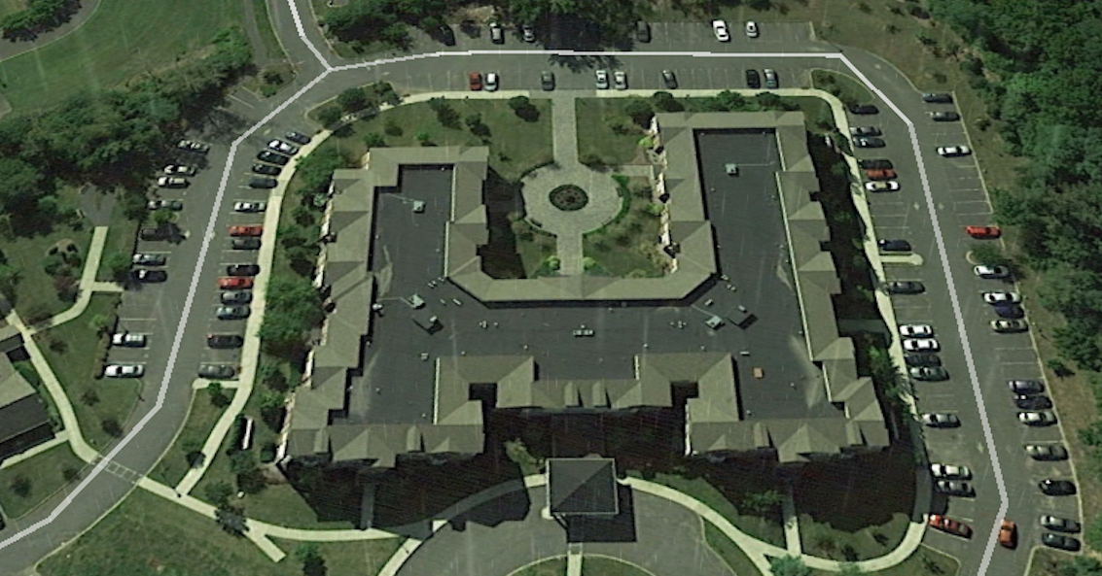
Access divisions 1-2-3 stairways
CD
BC
A-D
A-B

Slide 3
Access
Complex is Knox Box accessible.
Contact Mercer County Central
The code will be sent via the old VHF system
Access card is for the double lock doors
Access card is needed for basement entry
  Elevator machinery / hydraulic relief valve
  Sprinkler system / wet and dry valves
  Electrical room
  Annunciator panel

Slide 4
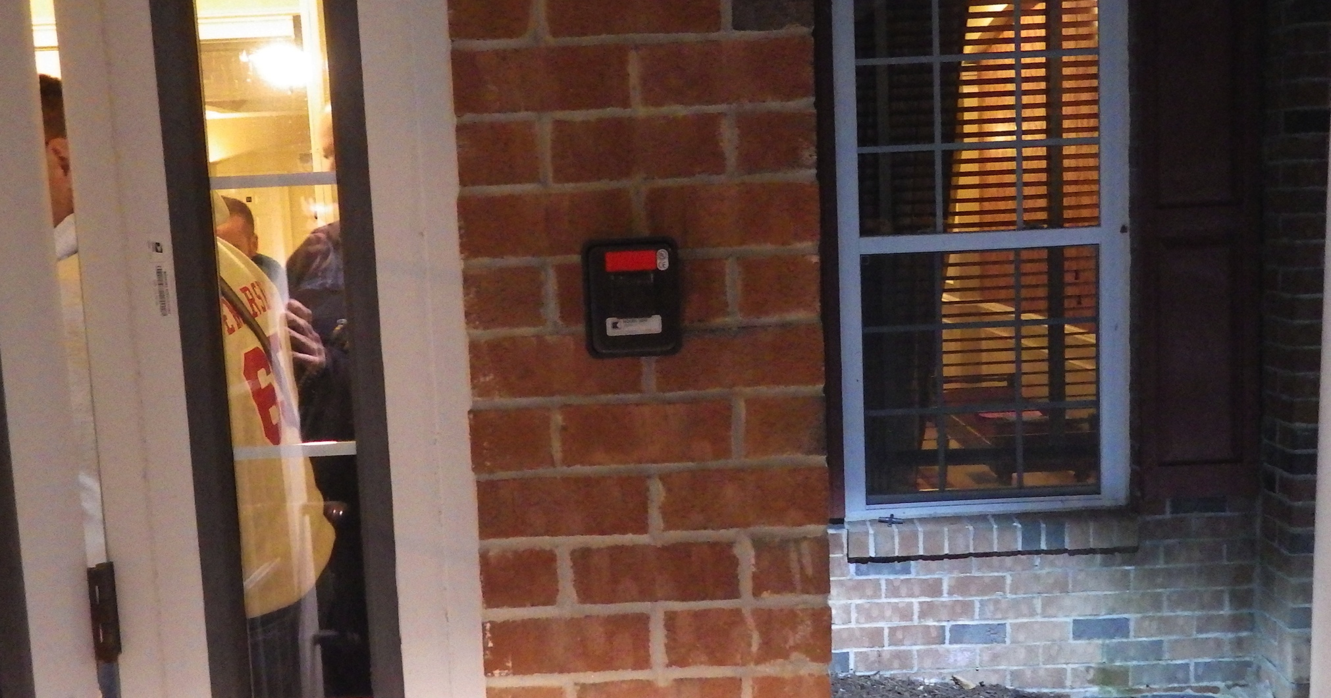

Slide 5
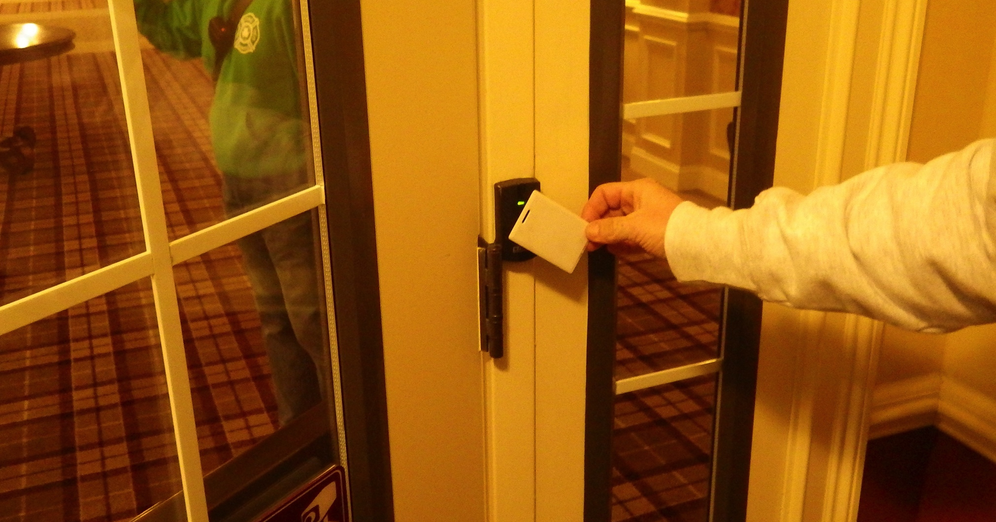
Interior card

Slide 6
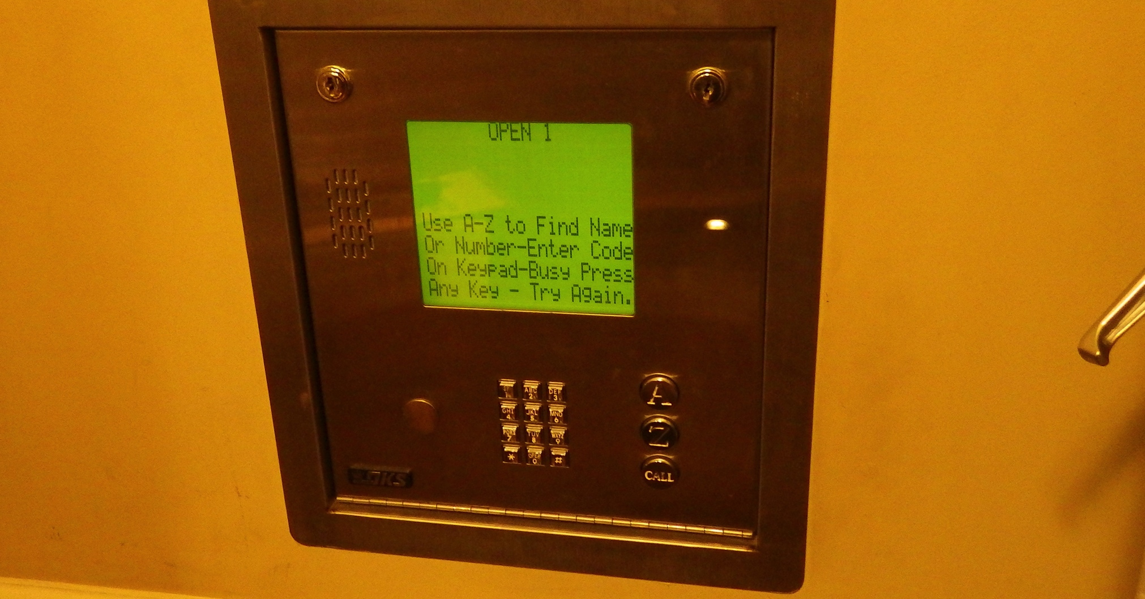
Lobby / apartment call box

Slide 7
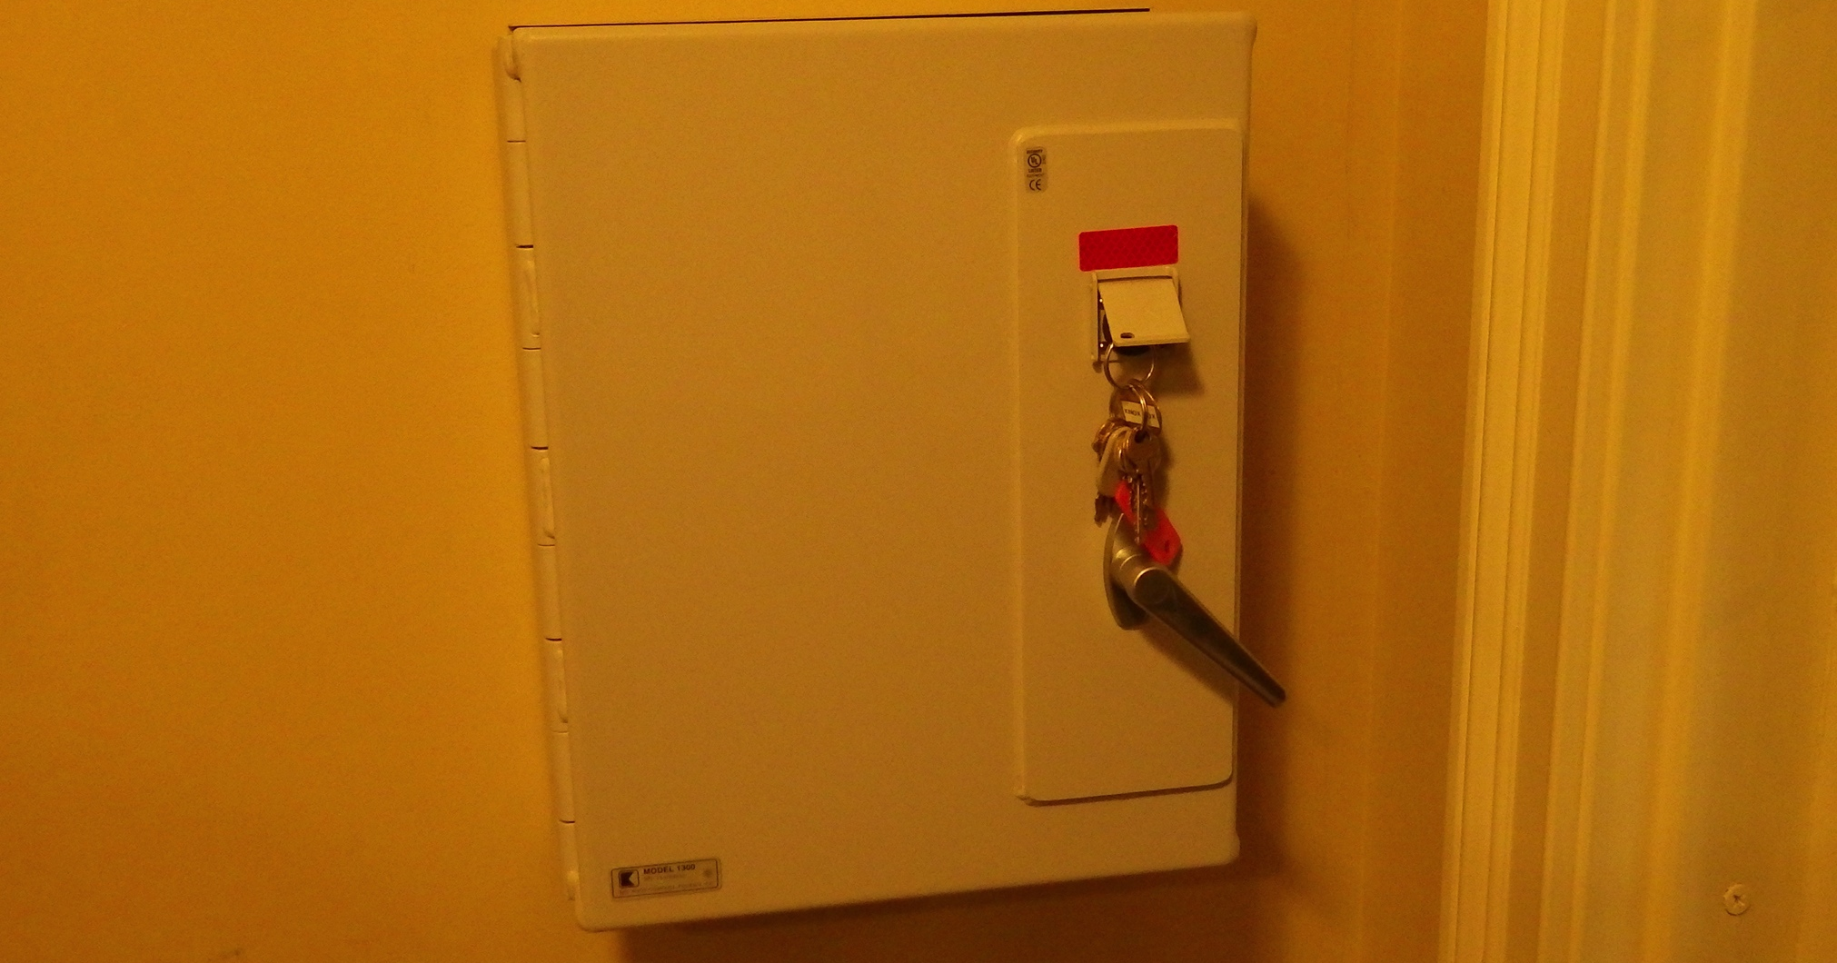
Apartment key storage
Keys from Knox Box

Slide 8
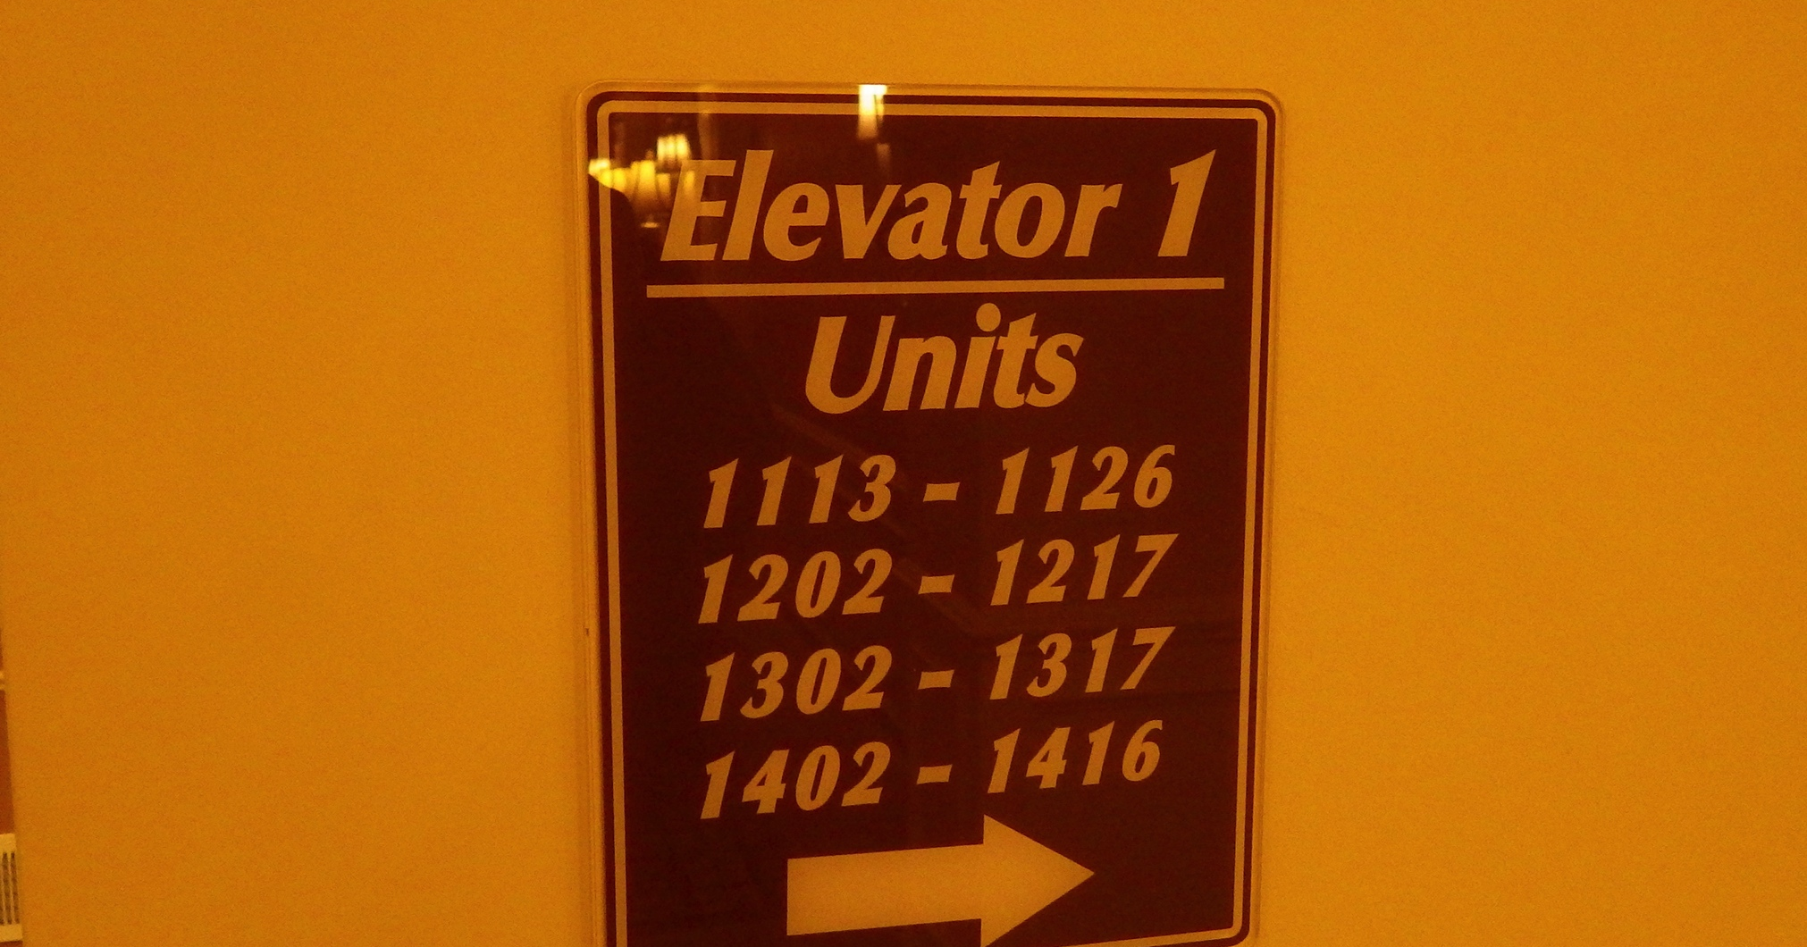
A-d side (princeton pike)

Slide 9
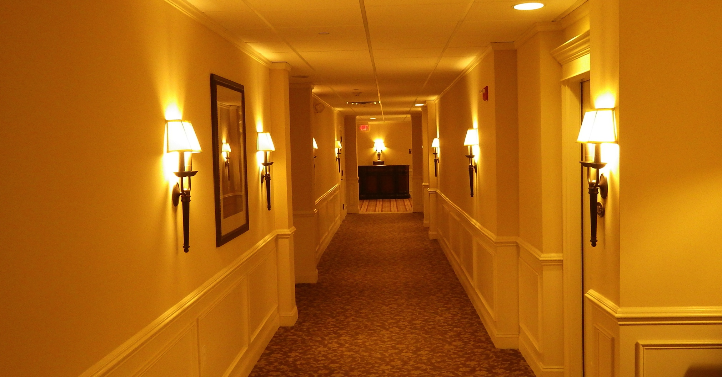
A side to d corridor

Slide 10
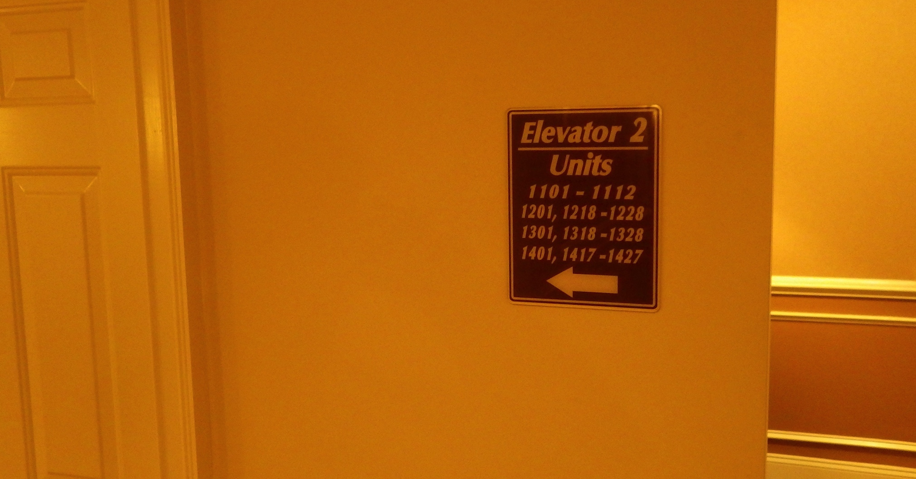
A-b side (us1)

Slide 11
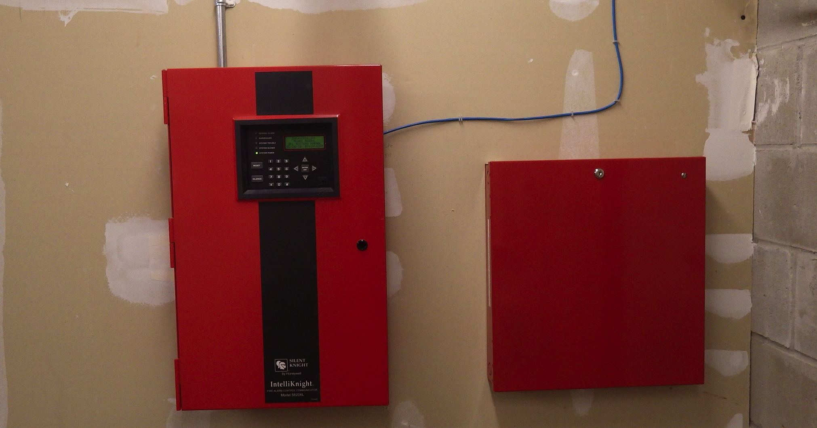
Basement alarm panel

Slide 12
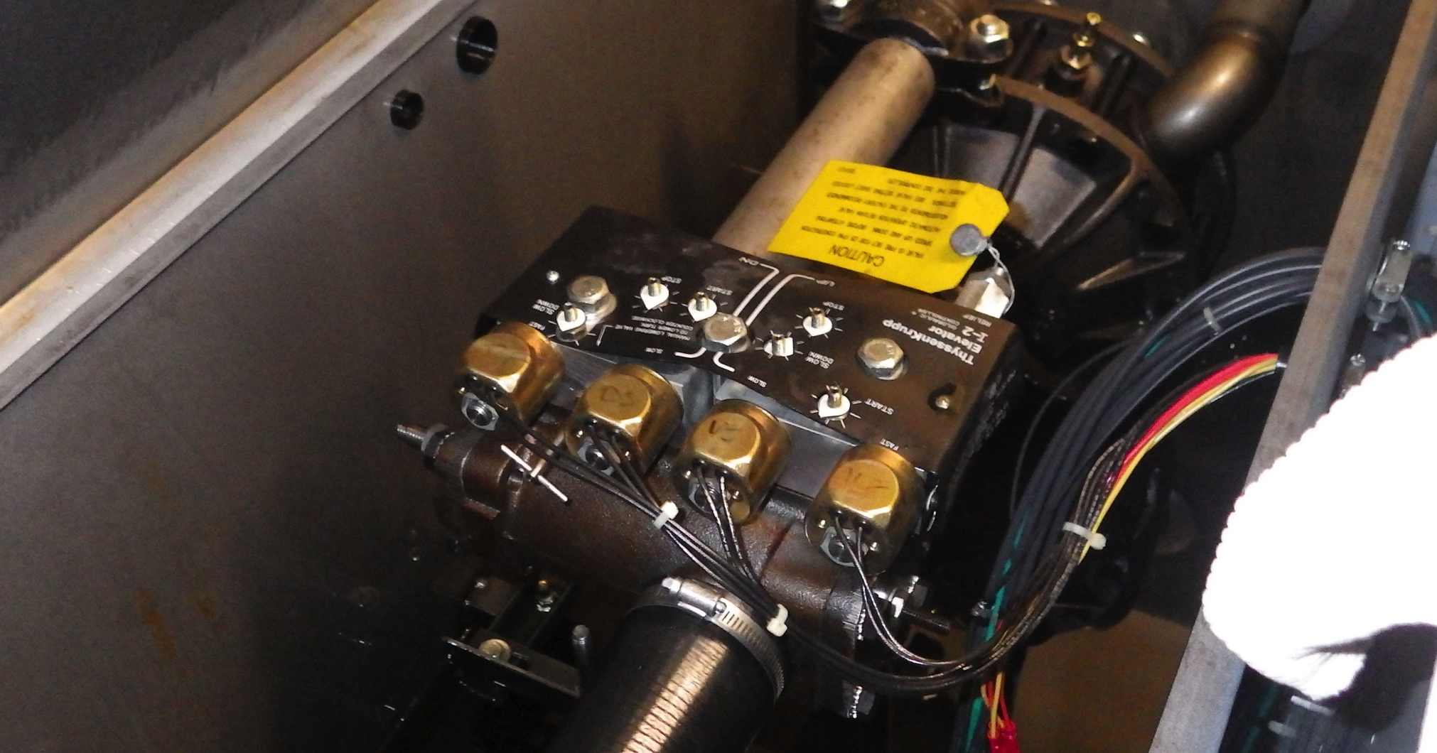
elevator lift assembly
Needle Valve can be used to lower elevator USE CAUTION

Slide 13
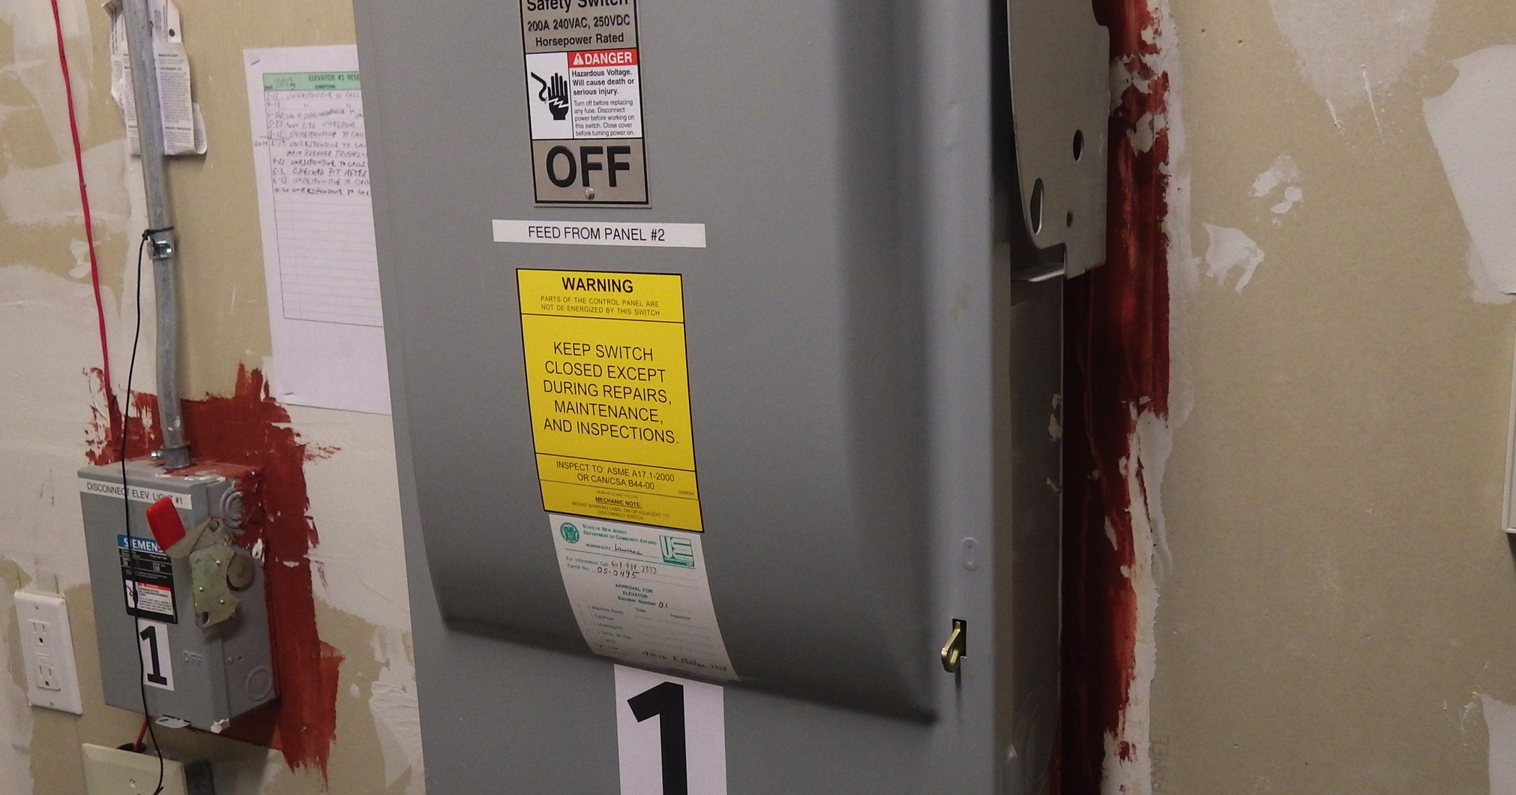
ELECTRICAL DISCONNECT

Slide 14
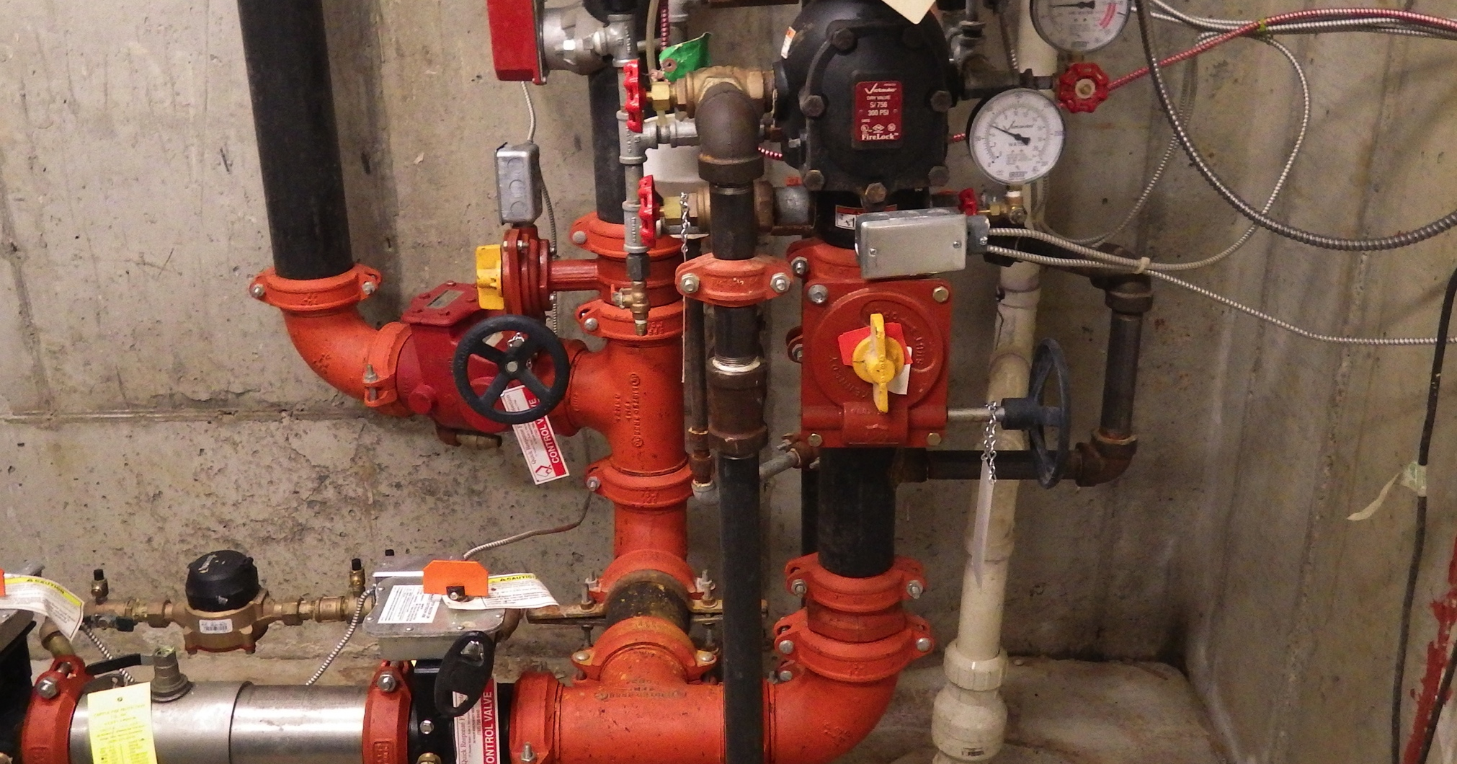
Sprinkler system

Slide 15
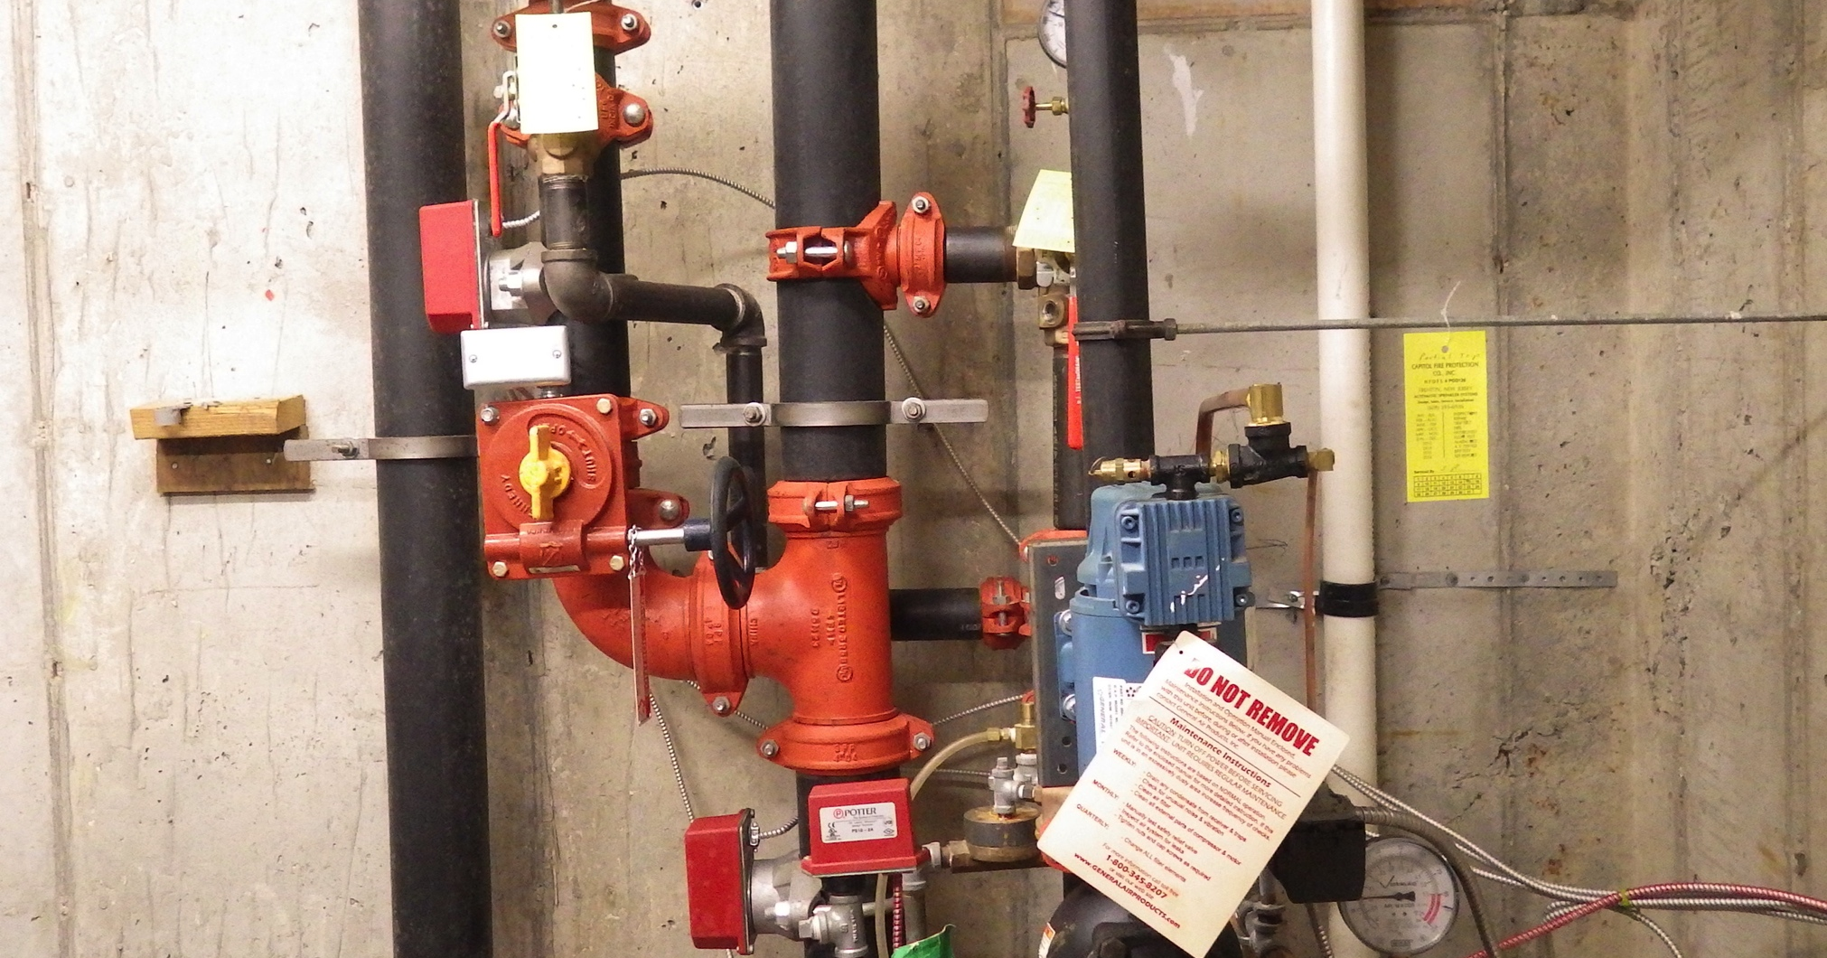
Wet system valve / dry valve

Slide 16
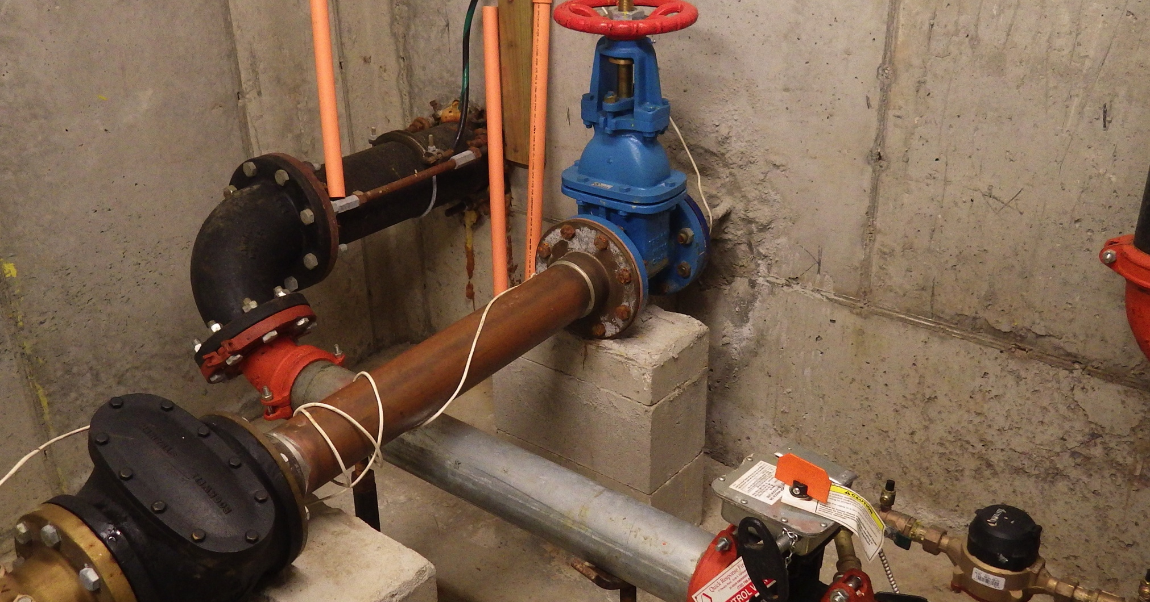
From fdc / domestic water

Slide 17
Exposure sides
C
B
D
A

Slide 18
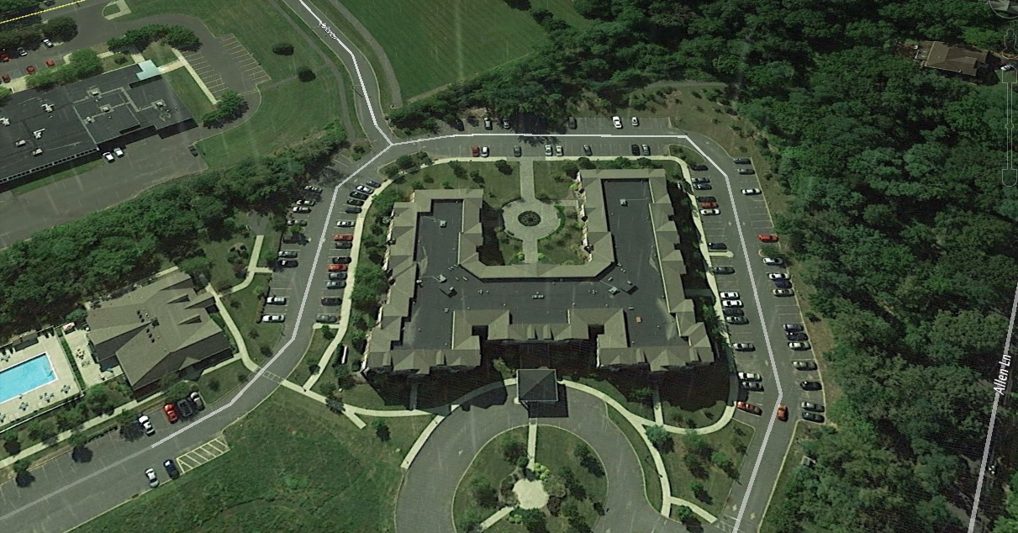
Grade level access only

Slide 19
Notes/ access/ utilities
Roof Access is on Division 4 at Bravo side.
HVAC units in the storage areas supply common areas only.
Gas meters are on the A/B corner and B/C corner.
All units have gas stoves.
All units have electric dryers.
The gas heaters for each unit are located on the balcony of each unit.

Slide 20
Notes / standpipes
All stairways have standpipe connections
All stairways have exterior access.
Hose lays floor to floor from standpipe / require 50’ hose.
From the Bravo and Delta standpipe into the corridor to the center of the corridor requires approximately 133 ‘ of hose.
Typically on 50’ length of hose is needed for interior apartment fire attack.

Slide 21
Additions / corrections
Please contact Capt. Ken Kandrac 609-883-5435 or bckk1@verizon.net for additions or corrections.

